Slide 1
Home screen widgets
Antti Mäkelä
Santeri Taponen

Slide 2
General
An essential aspect of home screen customization
Views important data and features from an app
Can be moved across the home screen panels and resized (if supported)

Slide 3
Types
Information widgets
Show important information and track information changes over time
Collection widgets
Display multiple elements of the same type
Control widgets
Display often used functions of an app without the need to open the app
Hybrid widgets
Combine elements of the other types

Slide 4
Limitations
Only available gestures are: touch and vertical swipe
Because of the gesture restriction, some UI building blocks are not available for widgets

Slide 5
Creating a widget
Inherit from AppWidgetProvider
public class MyCoolestWidget extends AppWidgetProvider {
public void onUpdate(Context, AppWidgetManager, int[] ids)
public void onEnabled(Context)
public void onDisabled(Context)
...
}

Slide 6
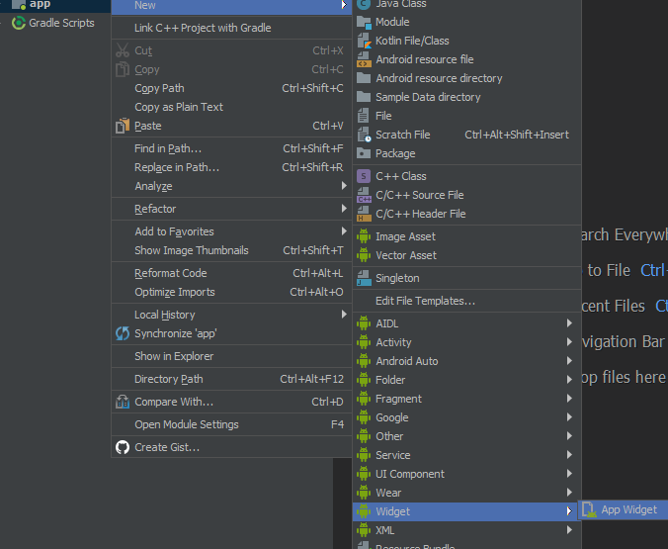
Or the easy way

Slide 7
RemoteViews
A view that can be transmitted between applications
Supports only a limited set of widgets, views and layouts
Has multiple methods for altering the internal behaviour
setTextViewText
setImageViewUri
setOnClickPendingIntent
And many others
App widgets are RemoteViews

Slide 8
AppWidgetProvider onUpdate
public void onUpdate(Context ctx, AppWidgetManager awm, int[] ids) {
for (int id : ids) {
RemoteViews rv =
new RemoteViews(ctx.getPackageName(), R.layout.my_widget);
rv.setTextViewText(R.id.my_text_view, "Widget "+id+"!");
awm.updateAppWidget(id, rv);
}
}

Slide 9
Intent filters for the AppWidgetProvider
<intent-filter>
<action android:name="android.appwidget.action.APPWIDGET_UPDATE" />
<action android:name="android.appwidget.action.ACTION_APPWIDGET_ENABLED" />
<action android:name="android.appwidget.action.ACTION_APPWIDGET_DISABLED" />
<action android:name="android.appwidget.action.ACTION_APPWIDGET_DELETED" />
...
</intent-filter>

Slide 10
When is my onUpdate called?
Every updatePeriodMillis
Can only update once per 30 minutes with this
Whenever the system feels like updating the widgets
When someone else requests the update implicitly

Slide 11
Updating them widgets with intents
Intent intent = new Intent(context, MyCoolestWidget.class);
intent.setAction(AppWidgetManager.ACTION_APPWIDGET_UPDATE);
AppWidgetManager appWidgetManager = AppWidgetManager.getInstance(context);
int[] ids = appWidgetManager.getAppWidgetIds(
new ComponentName(getApplication(), MyCoolestWidget.class));
intent.putExtra(AppWidgetManager.EXTRA_APPWIDGET_IDS, ids);
sendBroadcast(intent);

Slide 12
Control widgets
//Start MyActivity when my_button is clicked
Intent intent = new Intent(context, MyActivity.class);
PendingIntent pendingIntent = PendingIntent.getActivity(context,0,intent,0);
remoteViews.setOnClickPendingIntent(R.id.my_button, pendingIntent);

Slide 13
Collection widgets
What you'll need:
RemoteViewsFactory, which constructs the views for individual items
RemoteViewsService, to provide the RemoteViewsFactory

Slide 14
RemoteViewsService
<service android:name=".MyRemoteViewsService"
android:permission="android.permission.BIND_REMOTEVIEWS">
</service>
public class MyRemoteViewsService extends RemoteViewsService {
@Override
public RemoteViewsFactory onGetViewFactory(Intent intent) {
return new MyRemoteViewsFactory(...);
}
}

Slide 15
RemoteViewsFactory – The Important Parts
public class MyRemoteViewsFactory
implements RemoteViewsService.RemoteViewsFactory {
public MyRemoteViewsFactory(Context context, Intent intent)
public void onDataSetChanged()
public int getCount()
public RemoteViews getViewAt(int i)
...

Slide 16
More RemoteViewsFactory stuff
...
public void onCreate()
public void onDestroy()
//For custom loading view
public RemoteViews getLoadingView()
//How many different "view types" there is
public int getViewTypeCount()
public long getItemId(int i)
public boolean hasStableIds()
}

Slide 17
RemoteViewsFactory onDataSetChanged
public void onDataSetChanged()
{
//Load the data from database - may take 10 seconds
this.data = LoadDataArrayFromSomewhere();
}

Slide 18
public RemoteViews getViewAt(int i)
{
RemoteViews remoteViews = new RemoteViews(
myContext.getPackageName(),
R.layout.widget_list_item);
remoteViews.setTextViewText(
R.id.widget_item_text,
data.getText(i));
return remoteViews;
}

Slide 19
AppWidgetProvider also needs to know things
public void onUpdate(Context ctx, AppWidgetManager awm, int[] ids) {
...
Intent intent = new Intent(context, MyRemoteViewsService.class);
intent.putExtra(...);
intent.setData(
Uri.parse(intent.toUri(Intent.URI_INTENT_SCHEME))
);
remoteViews.setRemoteAdapter(R.id.my_list_view, intent);
...
}

Slide 20
Interaction with collections
setPendingIntentTemplate
Provide the target for all onClick in the collection
setOnClickFillInIntent
Provide extra per-item data for onClick

Slide 21
AppWidgetProvider onUpdate
Intent intent = new Intent(...)
intent.putExtra(...);
intent.setData(
Uri.parse(clickIntent.toUri(Intent.URI_INTENT_SCHEME)));
PendingIntent pendingIntent = PendingIntent.getBroadcast(
context, 0, intent, PendingIntent.FLAG_UPDATE_CURRENT);
remoteViews.setPendingIntentTemplate(R.id.my_list_view,
pendingIntent);

Slide 22
RemoteViewsFactory getViewAt:
...
Intent intent = new Intent();
intent.putExtra(EXTRA_LIST_ITEM_ID, (int)getItemId(i));
remoteViews.setOnClickFillInIntent(R.id.my_list_button, intent);
...

